Slide 1

Welcome!
23-25 June 2025, Berlin

Slide 2
Regional report Europe

Slide 3


Slide 4

ALBANIA Information and Data Protection Commissioner
Legal and regulatory update
Law “On the Protection of Personal Data” passed in December 2024. Commissioner’s term of office extended to seven years.
Important achievements
Albania hosted the 15th International Conference of Information Commissioners (ICIC) in Tirana from 3 to 5 June 2024.
Albanian Commissioner’s Office assumed the Chair-Secretariat of ICIC in December 2024.
Albanian Commissioner’s Office joined Council of Europe Expert Group on Access to Information (AIG).
Authorities’ current priorities
Successfully lead the role of Chair and Secretariat of the International Conference of Information Commissioners (ICIC) until June 2025, and during the Berlin Conference (THANK YOU!)

Slide 5
CROATIA The Information Commissioner of the Republic of Croatia
Legal and regulatory update
Amendments to the Law on the right to access information are currently under way and expected to be adopted by the end of 2025 after an in-depth evaluation of the Law conducted as part of a project implemented within the framework of the National Recovery and Resilience Plan.
Important achievements
EU Court of Justice accepted the position of the Information Commissioner on the Open Data Directive ruling that access to information does not fall within its scope.
Authorities’ current priorities
The Commissioner will start developing a mobile application, which will contain instructions on how to exercise rights, publication of contact information of all public authorities and the possibility of submitting them requests directly from the application.

Slide 6
European Ombudsman
Organisational changes
In December 2024, a new Ombudsman was elected. Teresa Anjinho was elected by the European Parliament as the successor to Emily O’Reilly.
Important achievements
The Ombudsman concluded an own-initiative inquiry into how the Council and the Commission handle public access requests for legislative documents.
In March 2024, the European Parliament unanimously approved the Ombudsman’s special report calling on the Commission to urgently deal with systemic delays in its handling of access requests.
Authorities’ current priorities
In 2024, 42% of EO inquiries concerned transparency and accountability. The majority of these cases was based on complaints concerning access to EU documents.

Slide 7
FRANCE Commission d’accès aux documents administratifs (CADA)
Organisational changes
The CADA has amended its internal regulations to allow cases relating to environmental matters to be handled by decisions issued under simplified procedure by the President to reduce processing times.
Two full-time legal drafting officers primarily dedicated to cases involving requests for environmental information were hired.
Important achievements
The CADA managed to keep the average processing time under control despite an increase of 10% in the number of requests.
Six training sessions organized (138 participants) and two regional visits (120)
An online training module for public officials and those responsible for access to administrative documents is being developed by CADA and will be available this summer.
Additional information
Pilot project: testing an artificial intelligence tool based on CADA’s doctrinal database to facilitate responses on subjects that have already been addressed.

Slide 8
Germany – Brandenburg Brandenburg Commissioner for Data Protection and Access to information
Legal and regulatory update
The new state (Land) government partners agreed to further develop a data strategy with regard to open data.
The Brandenburg Commissioner’s demands for a further development of the Act on the Inspection of Files and Access to Information into a transparency law have not been taken into account in the coalition agreement.
Authorities’ current priorities
Priority is given to case handling. The Commissioner’s office also advises authorities and applicants and analyzes court decision.

Slide 9
GERMANY: FEDERAL LEVEL The Federal Commissioner for Data Protection and Freedom of Information
Organisational changes
Commissioner Prof. Dr. Specht-Riemenschneider was elected The Federal Commissioner for Data Protection and Freedom of Information by the German Parliament (Bundestag) in Mai 2024 and was appointed to the position in September 2024.
Significant cases
New developments concerning anonymous or pseudonymous application under the Freedom of Information Act Decision of the Federal Administrative Court of 20 March 2024:
Processing of an applicant's postal address is permitted
According to the Freedom of Information Act, anonymous requests are inadmissible
Thank you so much for putting together such an amazing conference!!

Slide 10
HUNGARY National Authority for Data Protection and Freedom of Information
Legal and regulatory update
An amendment to the Law on the right to access information regarding procedure entered into force in January 1st 2024.
New provision added to the FOIA: the Authority shall twice a year monitor compliance with the requirements for transparency and accessibility of data of public interest at organs performing public duties, local governments and publicly owned companies and issue reports on the results of the monitoring procedure.
Scope of the publication obligation in the Central Information Register of Public Data extended to 12399 public bodies, now including local governments as well (originally 5551 public bodies).
Authorities’ current priorities
Continue with the monitoring procedures and transparency authority procedures as a way to identify problems in the publishing practice of public bodies and state-owned companies and work together with these organizations to resolve these issues successfully.

Slide 11
KOSOVO Information and Privacy Agency
Legal and regulatory update
New Regulation on Internal Procedure of Access to Public Documents Appeals Handling entered into force in 2025.
Important achievements
Organization of the Freedom of Information Week in October 2024
Issuance of 747 decisions, 99.3 % of which were executed
Imposition of 5 administrative fines to public institutions
Organization of the Case Handling Workshop for the European FOI authorities in May 2025
Authorities’ current priorities
Participation on the ‘Initiative 2020’ Conference in October 2025
Training program for officers of public institutions on proactive publication of public documents
Monitoring public institutions’ webpages

Slide 12
LUXEMBOURG Commission d’accès aux documents (CAD)
Legal and regulatory update
A bill on the promotion of professional journalism and democratic debate has been presented to Parliament. This bill aims to further align the current legal framework with the Tromsø Convention.

Slide 13
NORTH MACEDONIA Agency for Protection of the Right to Free Access to Public Information
Legal and regulatory update
Amendment of the Law on Free Access to Public Information currently under way
Authorities’ current priorities
Participation in the working group for the amendment of the Law
Twinning project 'Supporting the Free Access to Information – We Rise Together', funded by the Delegation of the European Union in Skopje
Enhance the proactive transparency of institutions, ensure timely responses to information requests, and reduce administrative silence.

Slide 14
PORTUGAL Comissão de Acesso aos Documentos Administrativos (CADA)
Organisational changes
New members of CADA have been designated during the past year, including a new President. Maria do Céu Dias Rosa das Neves was elected in October 2024.
Important achievements
In 2024, the 30th anniversary of the establishment of the Commission for Access to Administrative Documents (CADA), was celebrated:
a commemorative volume entitled Open Administration in Portugal – What Future? was published, offering an in-depth assessment of the current legal framework
a series of conferences and informational sessions were held – primarily targeting municipalities and regional governments – with a focus on the legal regime presently in force.
Authorities’ current priorities
Ensure the swift resolution of disputes between applicants requesting access to administrative documents and environmental information, and the entities subject to the access regime
Facilitate the dialogue between the parties before issuing an opinion
Contribute to awareness-raising efforts directed at entities bound by the access regime, by organising and participating in workshops, conferences, lectures, and training sessions.

Slide 15
SCOTLAND Scottish Information Commissioner
Legal and regulatory update
A Private Member’s Bill to reform Scotland’s FOI Act is expected to be laid in the Scottish Parliament in late May 2025.
The Scottish Government decided to take forward a FOI amendment bill after the 2023 consultation on FOI reform including proposals to extend of FOI to “third party” providers of social care services, a more structured and consistent approach to the use of its power to designate new bodies and a revision and update the FOI Act’s Codes of Practice.
Organisational changes
New online home: changed the website and email domain to (the shorter, clearer, more memorable and accessible) foi.scot
Important achievements
Highest ever number of decisions issued (303, more than the preceding two years combined)
FOI data dashboard launched which presents key data submitted by public bodies in an interactive, visual format.
Authorities’ current priorities
20th anniversary of FOI law in Scotland (from 1 Jan 2025): supporting a number of events and activities across the year to celebrate this important landmark, including events for the public, public bodies, and other stakeholders.
Additional information
FOI awards: The Scottish Information Commissioner’s office continue to work with our colleagues in the UK Information Commissioner’s Office to support the eCase FOI Awards, a award scheme which recognises and celebrates best practice in FOI within public bodies across the United Kingdom.

Slide 16
SLOVENIA Information Commissioner of the Republic of Slovenia
Important achievements
increased number of cases of misuse of freedom of information right (67 cases).
Increased number of appeals concerning environmental data (16 cases). Most of them were (at least partly) successful (14 cases).
IC answered 370 written requests, conducted 10 free training sessions, and addressed 980 practical questions through telephone counselling, prepared an online training session, and additionally short video materials.

Slide 17
SWITZERLAND Federal Data Protection and Information Commissioner (CH)
Legal and regulatory update
Revision of the Freedom of Information Ordinance under way to specify the number of working hours above which a fee may be charged for processing information requests
Organisational changes
One temporary hire approved due to backlog of pending cases and increased mediation requests
Additional information
Each year, the FDPIC publishes his annual report in three official languages as well as in English. It contains many information concerning his work as the information commissioner and provides a detailed overview of achievements and challenges concerning the freedom of information principle. The next annual report is going to be published 1 July 2025.

Slide 18
UNITED KINGDOM Information Commissioner (UK ICO)
Important achievements
In 2024/25, the ICO:
received 7639 new cases, their second highest ever
closed 7637 cases and achieved this with 10% less resource than this time last year
issued 2192 statutory decision notices and closed around 1700 cases (around 23%) informally
addressed poor practice in relation to requests for environmental information. Their first EIR practice recommendation to a water company issued in October 2024 has been adopted by all water companies in England and Wales
Authorities’ current priorities
Continue to promote openness and transparency by public bodies through their guidance, casework, enforcement and upstream work
Keep exploring ways to do things differently, including exploring how new technology (AI tools), can help ICO work smarter.
Further develop their quality assurance processes to help ensure that their work and outputs are continuously improving, being relevant, accessible and useful
A proposal for additional funding has been submitted as part of the next three-year spending review

Slide 19
SPAIN Council for Transparency and Good Governance
Legal and regulatory update
The new Statute of the Council for Transparency and Good Governance (IAA) was approved in July 2024
Organisational changes
Revised internal structure: General Secretariat and new units established within the Council
Important achievements
Organization of the Case Handling Workshop for the European FOI authorities in May 2024
New visual identity of the Council since mid 2024
New website under way (in production in July): an attractive and functional design, aimed at delivering an optimal user experience by enhancing both usability and accessibility for all visitors.
Authorities’ current priorities
10th anniversary of the establishment of the Council: organization of a number of events (conferences and seminars) across the year to celebrate this important landmark, such as the 3 day-seminar that will take place in Santander next week.
Review and update of the interpretative criteria of the Transparency and Access to Information Law

Slide 20
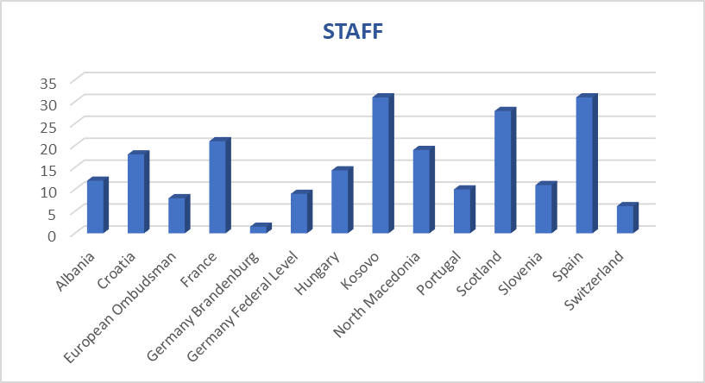

Slide 21
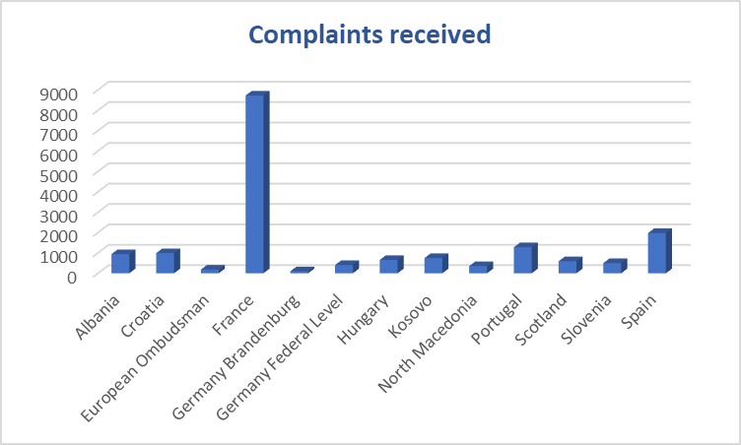

Slide 22
23-25 June 2025, Berlin

