Slide 1
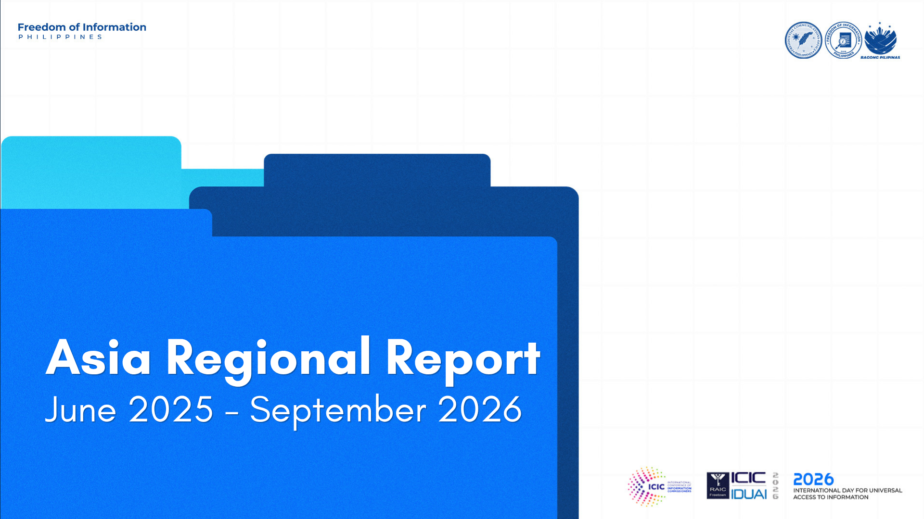
Notes:
Good morning, everyone.
On behalf of Asia, I am pleased to present our Regional Report covering developments from June 2025 to September 2026.
As part of the preparation of this report, a call for submissions was circulated to authorities in the region to share significant developments in access to information with broader regional or international relevance.
For this reporting period, we received submissions from three jurisdictions: the Maldives, the Philippines, and Taiwan.
Let me start with the Maldives.

Slide 2

Priority Development 1: All Government Ministries Achieve Minimum Proactive Disclosure Requirements
What happened?
In 2026, all government ministries in the Maldives, together with the President’s Office and the Attorney General’s Office, fulfilled the minimum proactive disclosure requirements established under the clause 37 of RTI Act. The assessment found that these institutions had made the minimum required categories of public information available without requiring citizens to submit individual information requests.
Why is it important?
This is an important milestone because it is the first time that all government ministries, along with the President’s Office and the Attorney General’s Office, have collectively met the minimum proactive disclosure standard. It demonstrates a substantial improvement in compliance by institutions at the center of government and strengthens the public’s ability to access essential government information directly and conveniently.
Effective proactive disclosure reduces the need for individual RTI requests, promotes transparency by default, and enables citizens, journalists, civil society organizations, and other stakeholders to monitor government policies, decisions, services, and the use of public resources. It also reflects the impact of sustained monitoring, guidance, engagement, and compliance efforts undertaken by the ICO.
Implications for other jurisdictions or the international ATI community
The Maldives’ experience demonstrates how systematic monitoring, clearly defined minimum disclosure criteria, and sustained engagement with public authorities can improve proactive disclosure across the executive branch. It also shows the value of monitoring institutions over several years and publishing comparable results to measure institutional progress.
The achievement may be especially relevant to jurisdictions seeking to shift from a request-based RTI system toward transparency by default. The Maldives’ approach could support regional learning on developing minimum proactive disclosure standards, assessing public authority websites, communicating compliance gaps, and working with senior government institutions to achieve coordinated improvement.
Notes:
This year, all government ministries in the Maldives, together with the President’s Office and the Attorney General’s Office, achieved the minimum proactive disclosure requirements established under their Right to Information Act.
This marked the first time that all of these institutions collectively met the minimum standard, making required categories of public information available without the need for individual information requests.
Beyond the achievement itself, the Maldives experience demonstrates how systematic monitoring, clearly defined disclosure criteria, and sustained engagement with public authorities can contribute to stronger compliance.
For other jurisdictions, this provides a useful example of moving from a predominantly request-based system toward transparency by default, particularly through minimum disclosure standards and regular compliance monitoring. [Next Slide: Philippines]

Slide 3
Priority Development 2: Progress toward the Passage of a National Right to Information Law
What happened?
The Philippines made significant legislative progress toward establishing a comprehensive national Right to Information (RTI) law. Following its inclusion in the Legislative-Executive Development Advisory Council (LEDAC) Common Legislative Agenda in September 2025, the Senate approved its version of the proposed RTI law on 4 May 2026, followed by the House of Representatives on 9 June 2026. Both versions are currently awaiting bicameral conference committee deliberations.
Why is it important?
Currently, the Philippines implements its Freedom of Information Program primarily through Executive Order No. 2, s. 2016, which covers only the Executive Branch. The progress of the proposed RTI Law signifies an important step to institutionalizing the country’s legal framework after more than 30 years of lobbying.
Implications for other jurisdictions or the international ATI community
The Philippine experience may offer a useful example of how an ATI framework established through an executive order can continue to operate and evolve despite its limited coverage, while efforts toward comprehensive national legislation are underway. It also demonstrates how existing administrative mechanisms can help sustain access to information and provide a foundation for further institutionalization through legislation.
Notes:
Turning to the Philippines, significant legislative progress was made toward establishing a comprehensive national Right to Information law.
Following its inclusion in the LEDAC Common Legislative Agenda in September 2025, the Senate approved its version of the proposed RTI law on 4 May 2026, followed by the House of Representatives on 9 June 2026. Both versions are currently awaiting bicameral conference committee deliberations.
This is particularly significant because the Philippine FOI Program currently operates primarily under Executive Order No. 2, series of 2016, which covers only the Executive Branch.
The Philippine experience can serve as an example of how an administrative ATI framework can continue to operate and evolve while comprehensive national legislation is being pursued, providing a foundation for further institutionalization through law. [Next Slide: Taiwan]

Slide 4
Priority Development 3: From Access to Information to AI-Ready Data: Taiwan’s Sovereign AI Training Corpus Builds a Trustworthy Cross-Border Data Foundation
What happened?
Taiwan has established the “Taiwan Sovereign AI Training Corpus,” which went live in December 2025, prioritizing corpus contributions from central government agencies such as the Ministry of Culture, the Ministry of Education, the Council of Indigenous Peoples, and the Hakka Affairs Council. As of the end of August 2026, more than 200 government agencies have contributed, with a cumulative total of approximately 5,000 datasets (about 2 billion tokens) made available for domestic and international AI model developers to apply to use.
Why is it important?
This initiative expands the concept of “access to information” beyond simply making information available for public viewing, to structuring public-sector knowledge so that it is reusable and suitable for AI training. It lowers the barrier for AI developers to obtain high-quality local corpora while safeguarding rights holders’ interests, elevating the value of public information from “open browsing” to “supporting AI innovation,” and helping AI systems better understand Taiwan’s linguistic context, culture, history, and social context.
Implications for other jurisdictions or the international ATI community
Taiwan’s experience shows that ATI policy can be further extended to govern data accessibility and reuse in the AI era. Through an integrated model of “openness, licensing, standardization, and AI-readiness,” Taiwan’s approach may offer Asian countries a new policy pathway: enhancing the visibility of local languages and cultural data within the global AI ecosystem, while enabling cross-border collaboration so that high-quality local corpora can support the development of international AI models—demonstrating a cross-border model that balances access to information, cultural diversity, and responsible AI development.
Notes:
Finally, Taiwan reported an emerging development on the relationship between access to information and the reuse of public-sector data for artificial intelligence.
In December 2025, Taiwan launched the Taiwan Sovereign AI Training Corpus. As of the end of August 2026, more than 200 government agencies had contributed approximately 5,000 datasets, equivalent to around two billion tokens, which may be made available for use by domestic and international AI model developers.
What is particularly relevant for the ATI community is the way this initiative expands the concept of access beyond simply making information available for public viewing. It considers how public-sector information can also be structured, standardized, and made reusable and suitable for AI development.
Taiwan’s experience therefore offers an emerging example of how ATI policy may evolve in the AI era, particularly through the combination of openness, licensing, standardization, and AI-readiness, while also considering cultural diversity and the interests of rights holders. [Next Slide: Emerging Trends]

Slide 5
Emerging Trends, Risks, and Opportunities
EMERGING TREND
Expanding scope of access to information
ATI is evolving beyond request-based access toward proactive disclosure, stronger institutional frameworks, and the responsible reuse of public information, including AI-ready data.
EMERGING CHALLENGE
Consistent, inclusive, and responsible implementation
Ensuring institutional capacity, accessibility, public awareness, and sustained disclosure, while addressing emerging considerations on data quality, standardization, licensing, privacy, and rights-holder protection.
OPPORTUNITY
Regional knowledge-sharing
Exchange of practical approaches on proactive disclosure, legal and institutional frameworks, digital and inclusive access, and responsible public-data reuse in the AI era.
Notes:
Looking at the three submissions, there are a few observations that we can draw.
First, we are seeing the scope of access to information continue to expand.
The developments reported by the three jurisdictions reflect different dimensions of this shift. We see ATI moving beyond simply responding to information requests toward stronger proactive disclosure, more institutionalized frameworks, and new ways of making public information accessible and reusable.
At the same time, consistent, inclusive, and responsible implementation remains a challenge. Institutional capacity, accessibility, public awareness, and sustained disclosure remain important considerations. And with the increasing use and reuse of public data, emerging issues such as data quality, standardization, licensing, privacy, and the protection of rights holders are also becoming more relevant.
Finally, these developments provide more opportunities for regional knowledge-sharing. There is a lot that we can learn from each other, whether on proactive disclosure, strengthening legal and institutional frameworks, improving digital and inclusive access, or exploring the responsible reuse of public data in the era of AI.
And this concludes the Regional Report for Asia.
We hope that future reporting cycles will capture developments from more jurisdictions and continue to strengthen the exchange of ATI experiences across the region.
Thank you very much.

